Slide 1
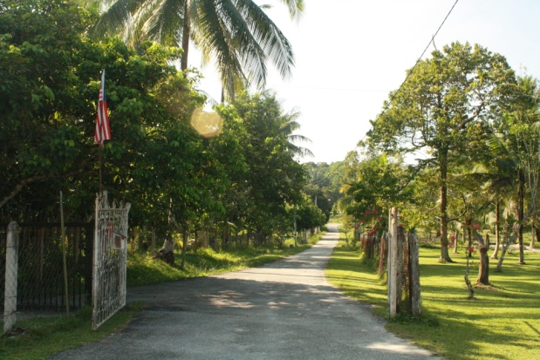
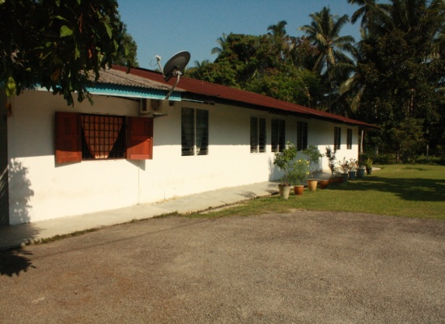
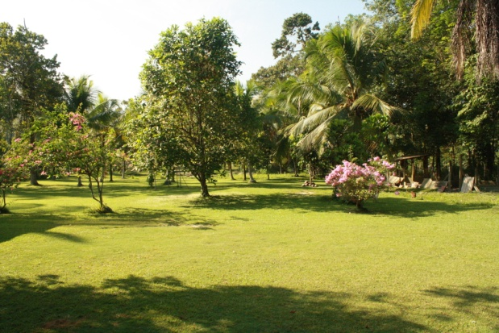
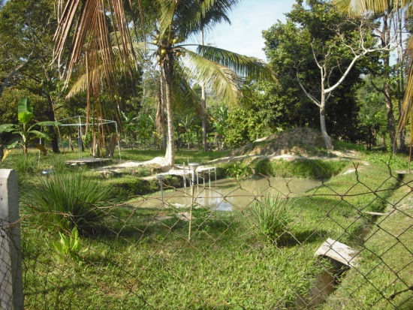
PROJECT 8
Constructing For Real
Community Construction One Malaysia
Friday 2nd Oct - Sunday 4th October 2009
KHOR SHUIN CHENG (103680)
QUANTITY SURVEYING

Slide 2
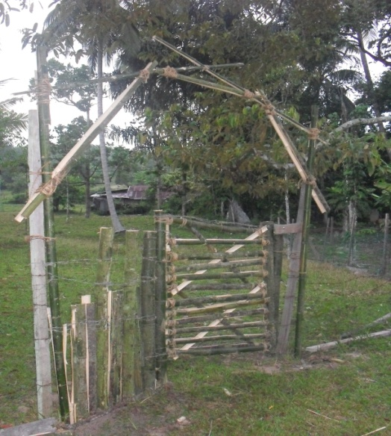
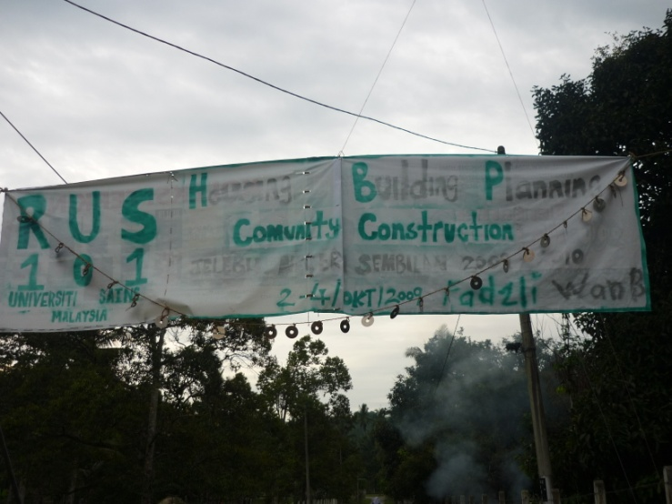
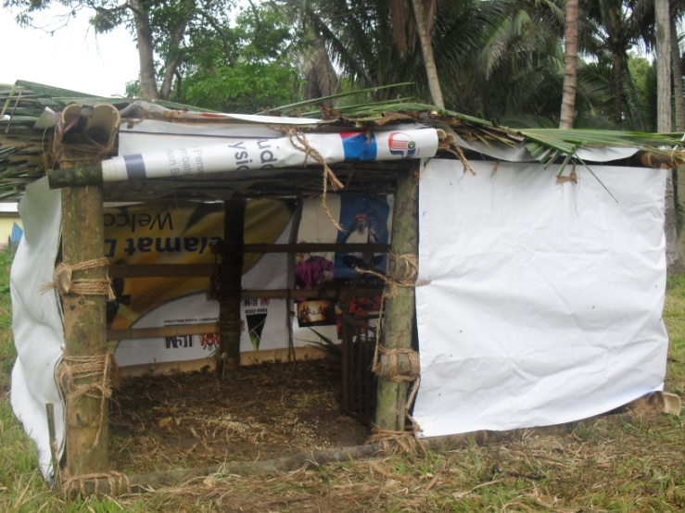
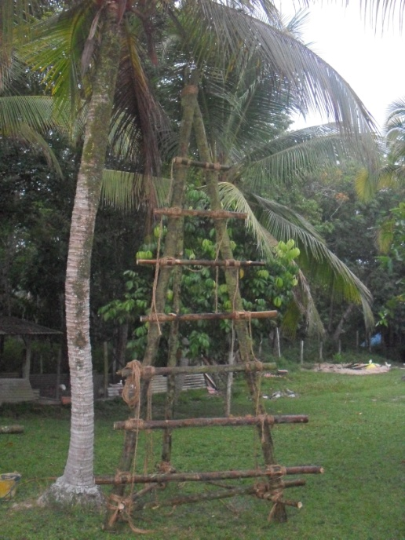
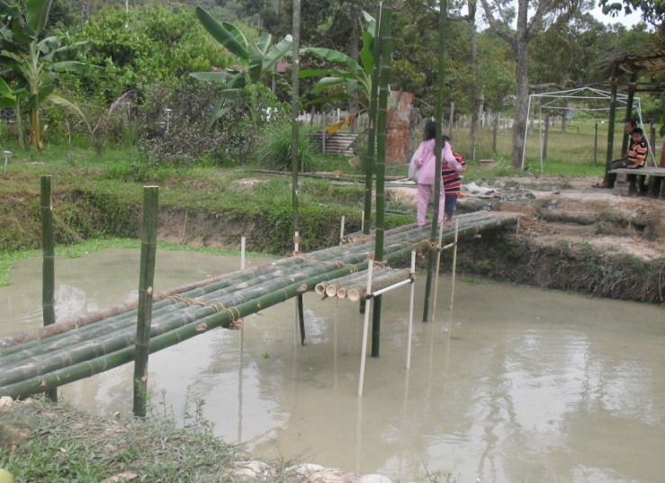
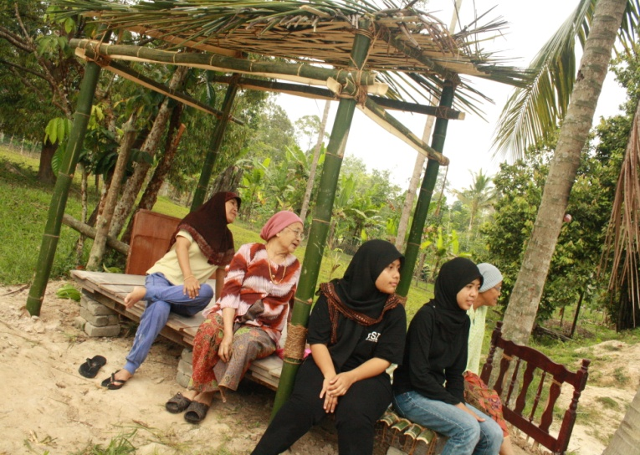
CONSTRUCTION FOR REAL
Jelebu , Negeri Sembilan
GATE
BANNER
CHICKEN HUT
BRIDGE
GAZEBO
COCONUT TOWER
KHOR SHUIN CHENG (103680)
QUANTITY SURVEYING

Slide 3
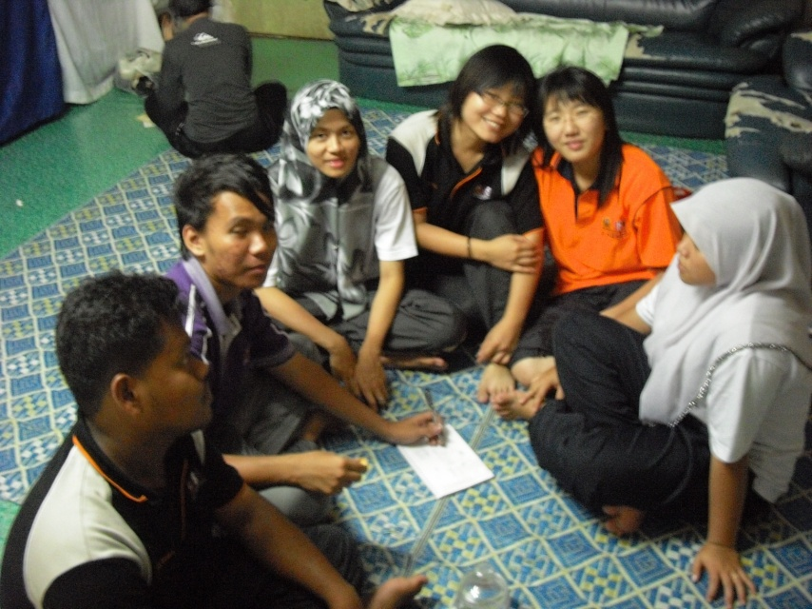
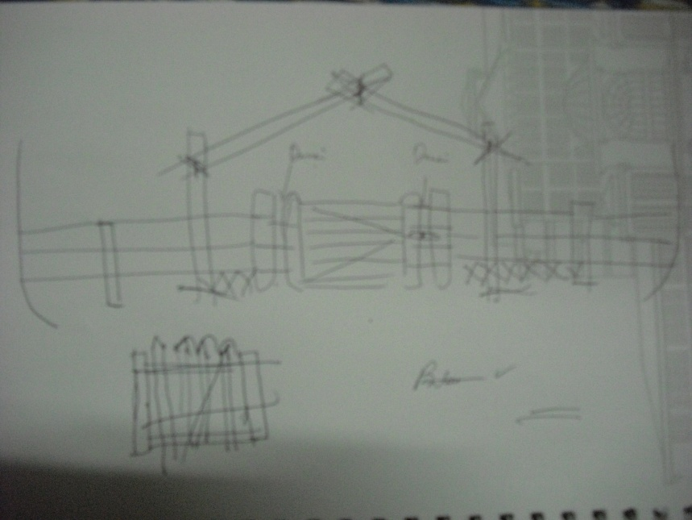
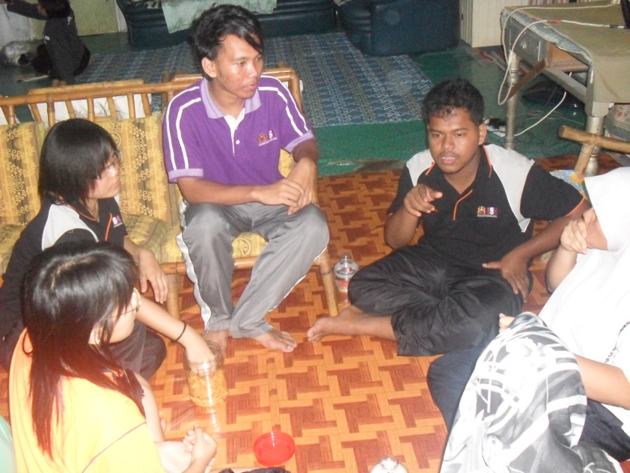
Our plan!!!
Group member for GATE:
Ariff, Zaidi, Faizah, Hasanah,
Bee Kee, and me(Shuin Cheng)
DISCUSSION
KHOR SHUIN CHENG (103680)
QUANTITY SURVEYING

Slide 4
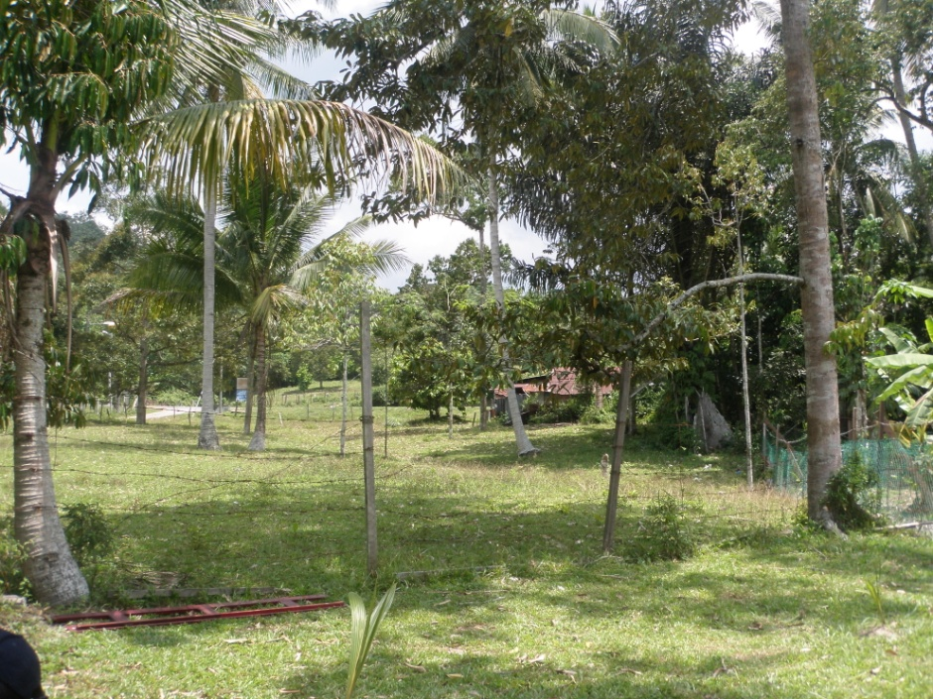

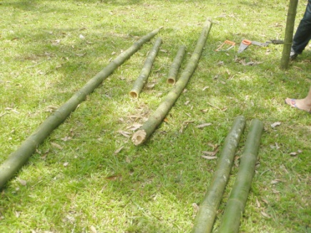
BEFORE
AFTER
GATE…
GATE…
Bamboo again !
KHOR SHUIN CHENG (103680)
QUANTITY SURVEYING

Slide 5
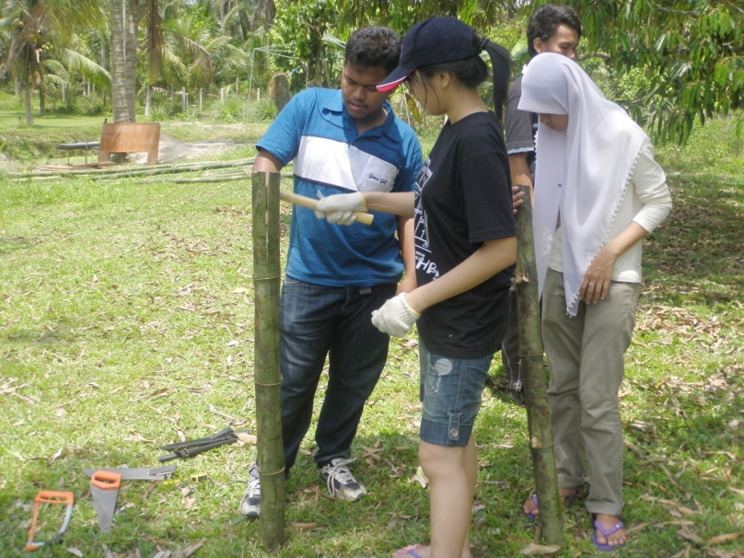
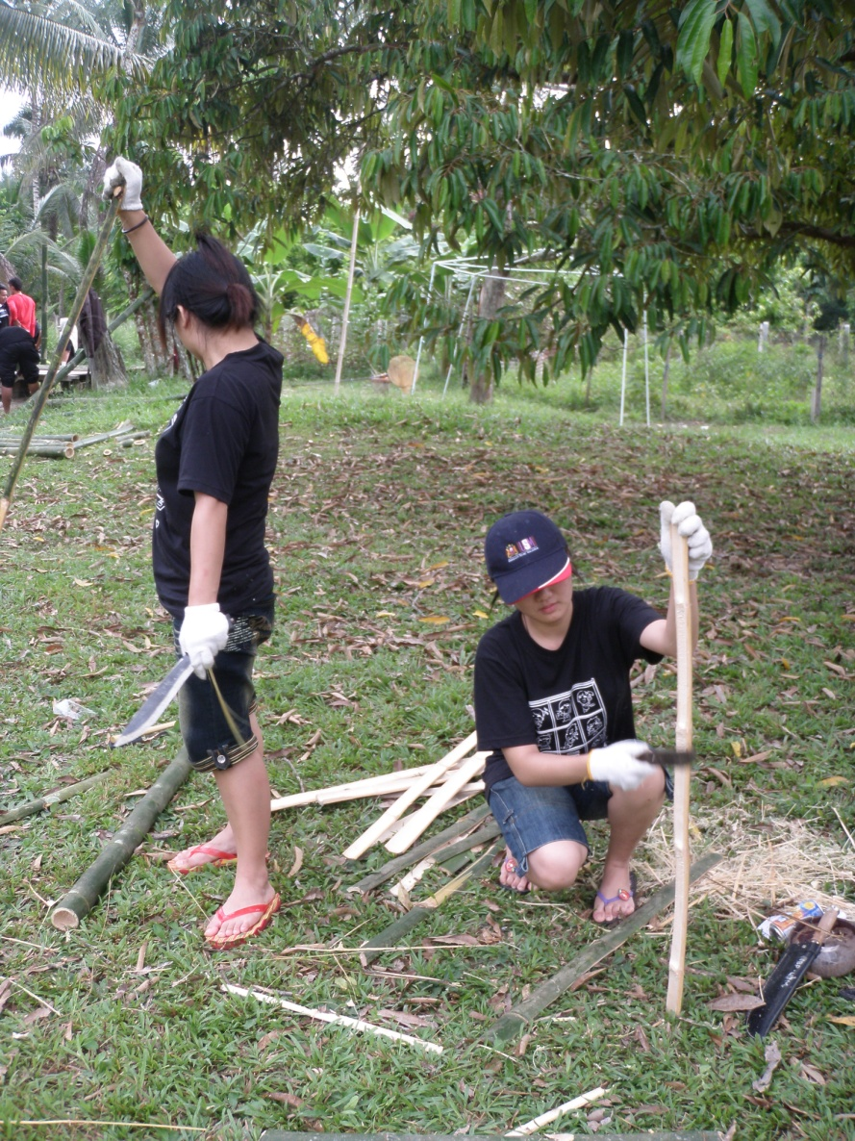
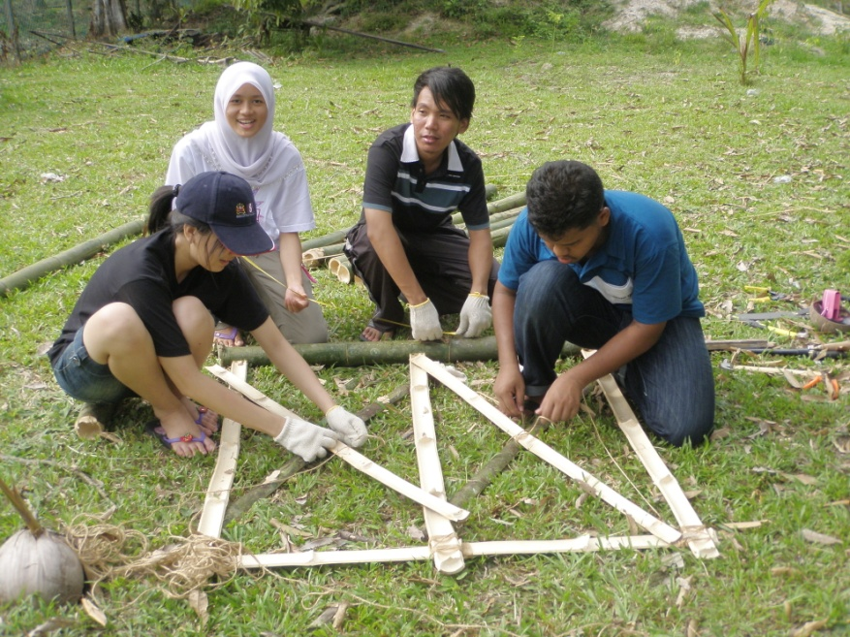
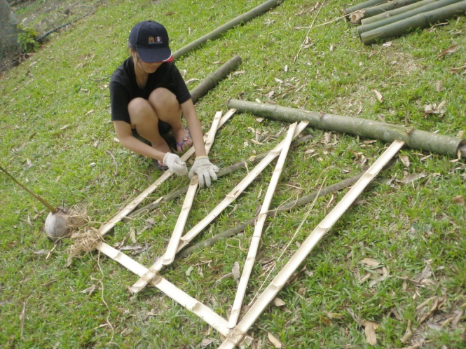
My contribution to the community…
Constructed a GATE
Cutting bamboo into half
Making the gate frame
Using PARANG
KHOR SHUIN CHENG (103680)
QUANTITY SURVEYING

Slide 6
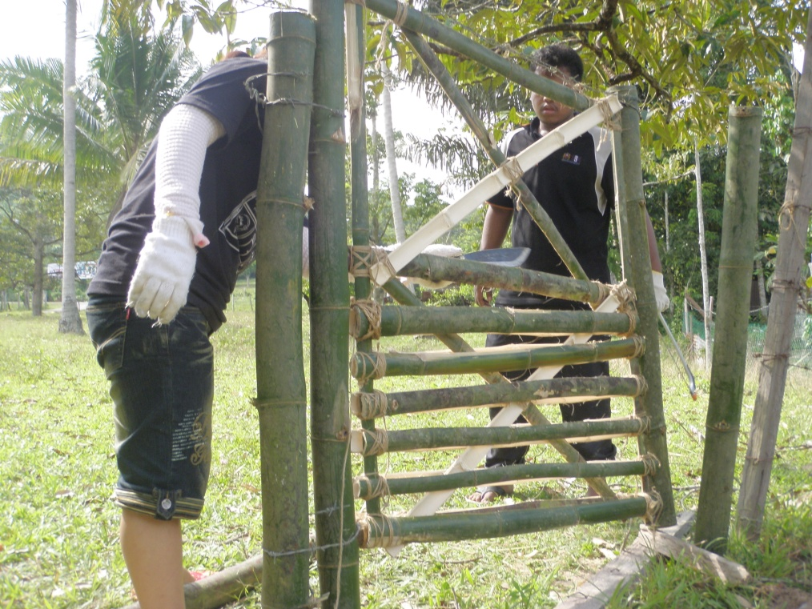
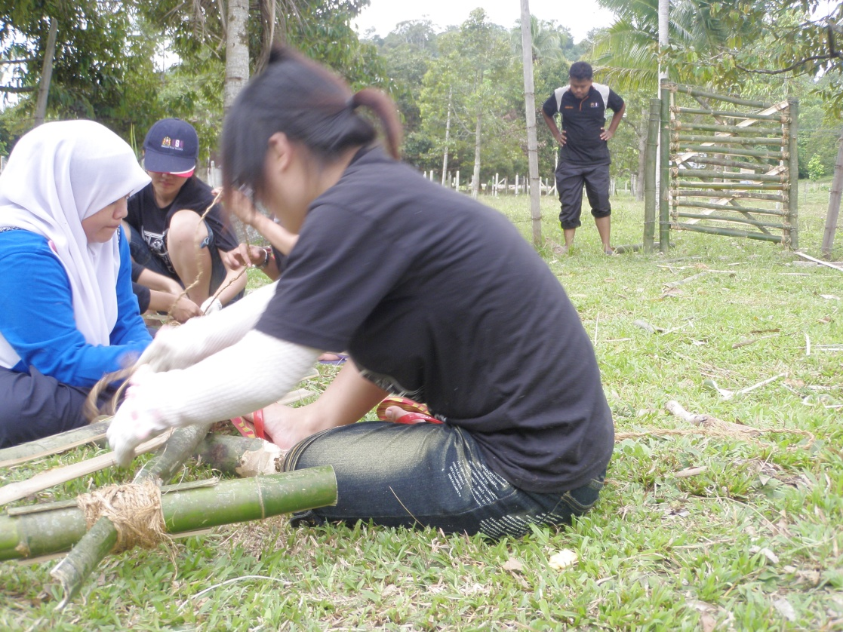
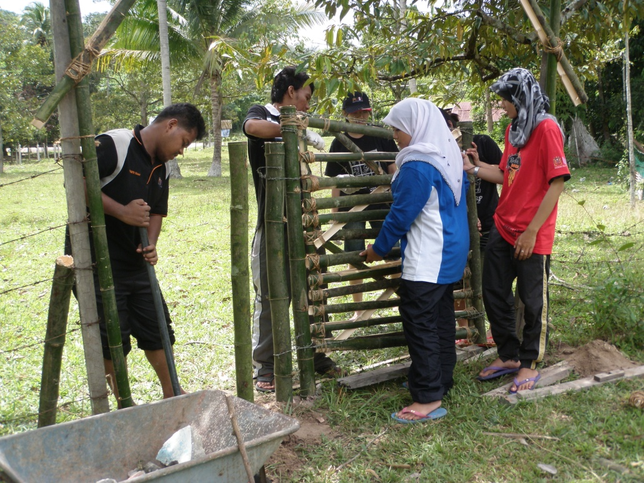
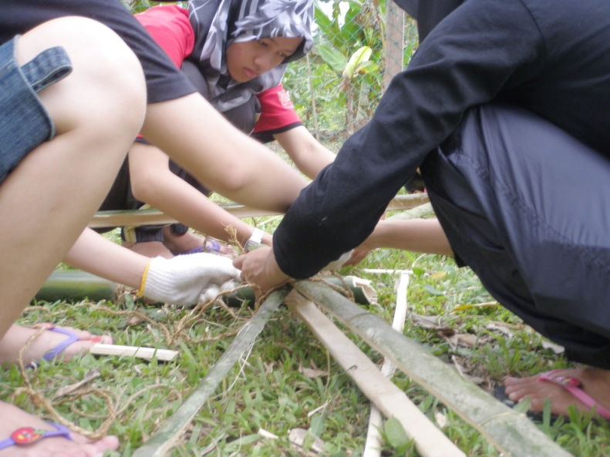
REINFORCEMENT
KHOR SHUIN CHENG (103680)
QUANTITY SURVEYING

Slide 7
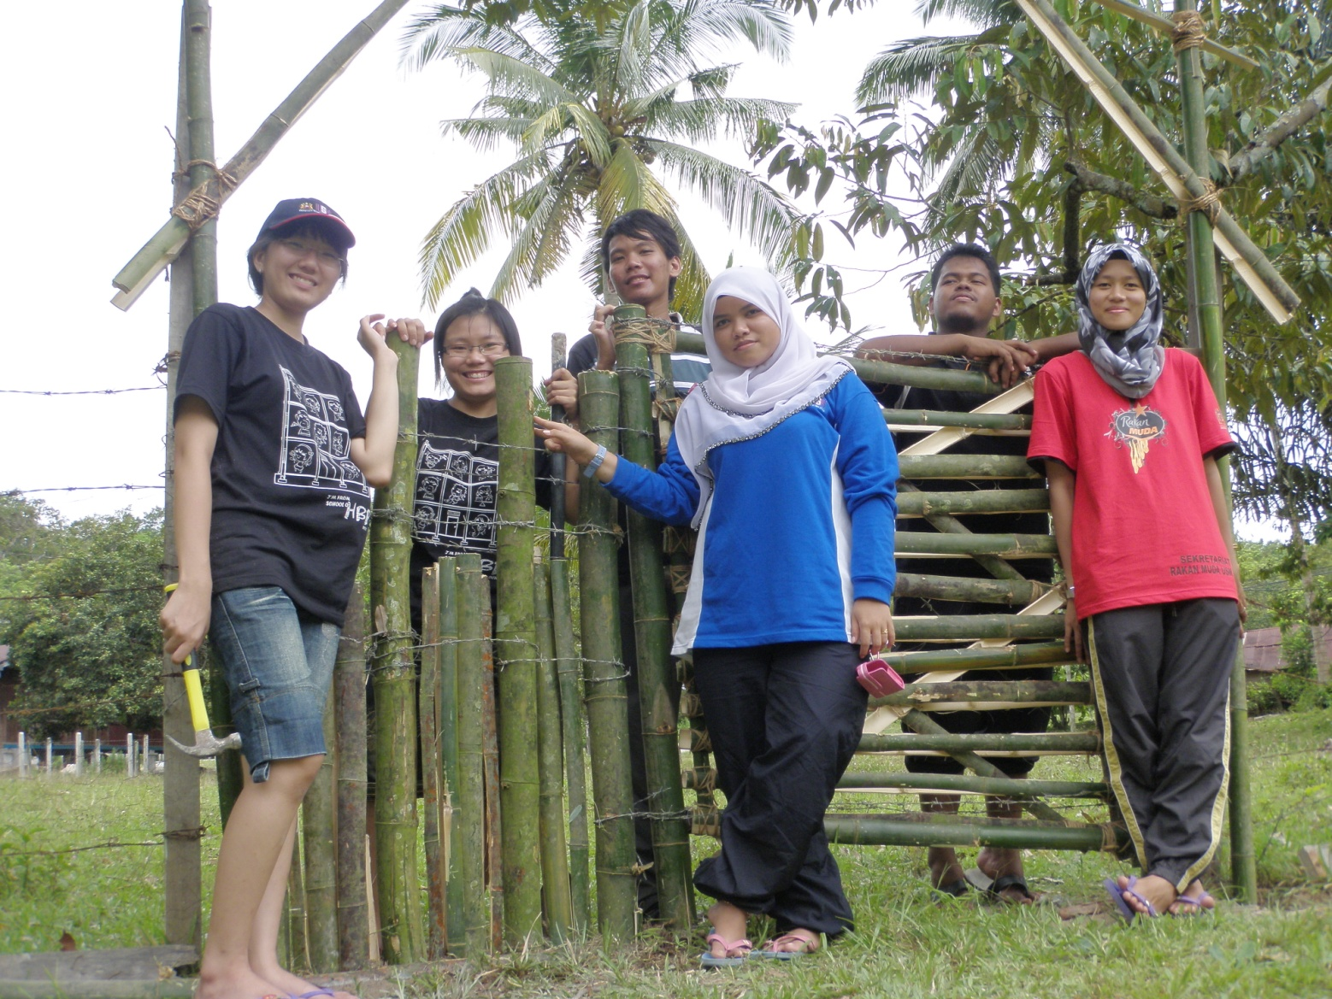
FINALLY, OUR GATE DONE
KHOR SHUIN CHENG (103680)
QUANTITY SURVEYING

Slide 8
WHAT I HAVE LEARNT DURING THE JEREBU, NEGERI SEMBILAN TRIP ?
FROM NOTHING TO SOMETHING. THIS IS WHAT I HAVE LEARNT ABOUT. GATE IS THE WAY IN AND OUT. WE BUILT THE GATE FOR THE CONVENIENTOF THE USERS. WE EXPERIENT THE PROCESS OF BUIDT UP A GATE. IT IS NOT EASY THAT WE EXPERTED. FROM THE BEGINNING TO THE END, COOPERATION BETWEEN OUR GROUP MEMBERS CAN BE SEEN FROM THE PHOTOS. WE REALLY APPRECIATED EACH OTHER ABLE TO COMPLETE OUR JOB ON TIME.
KHOR SHUIN CHENG (103680)
QUANTITY SURVEYING

Slide 9
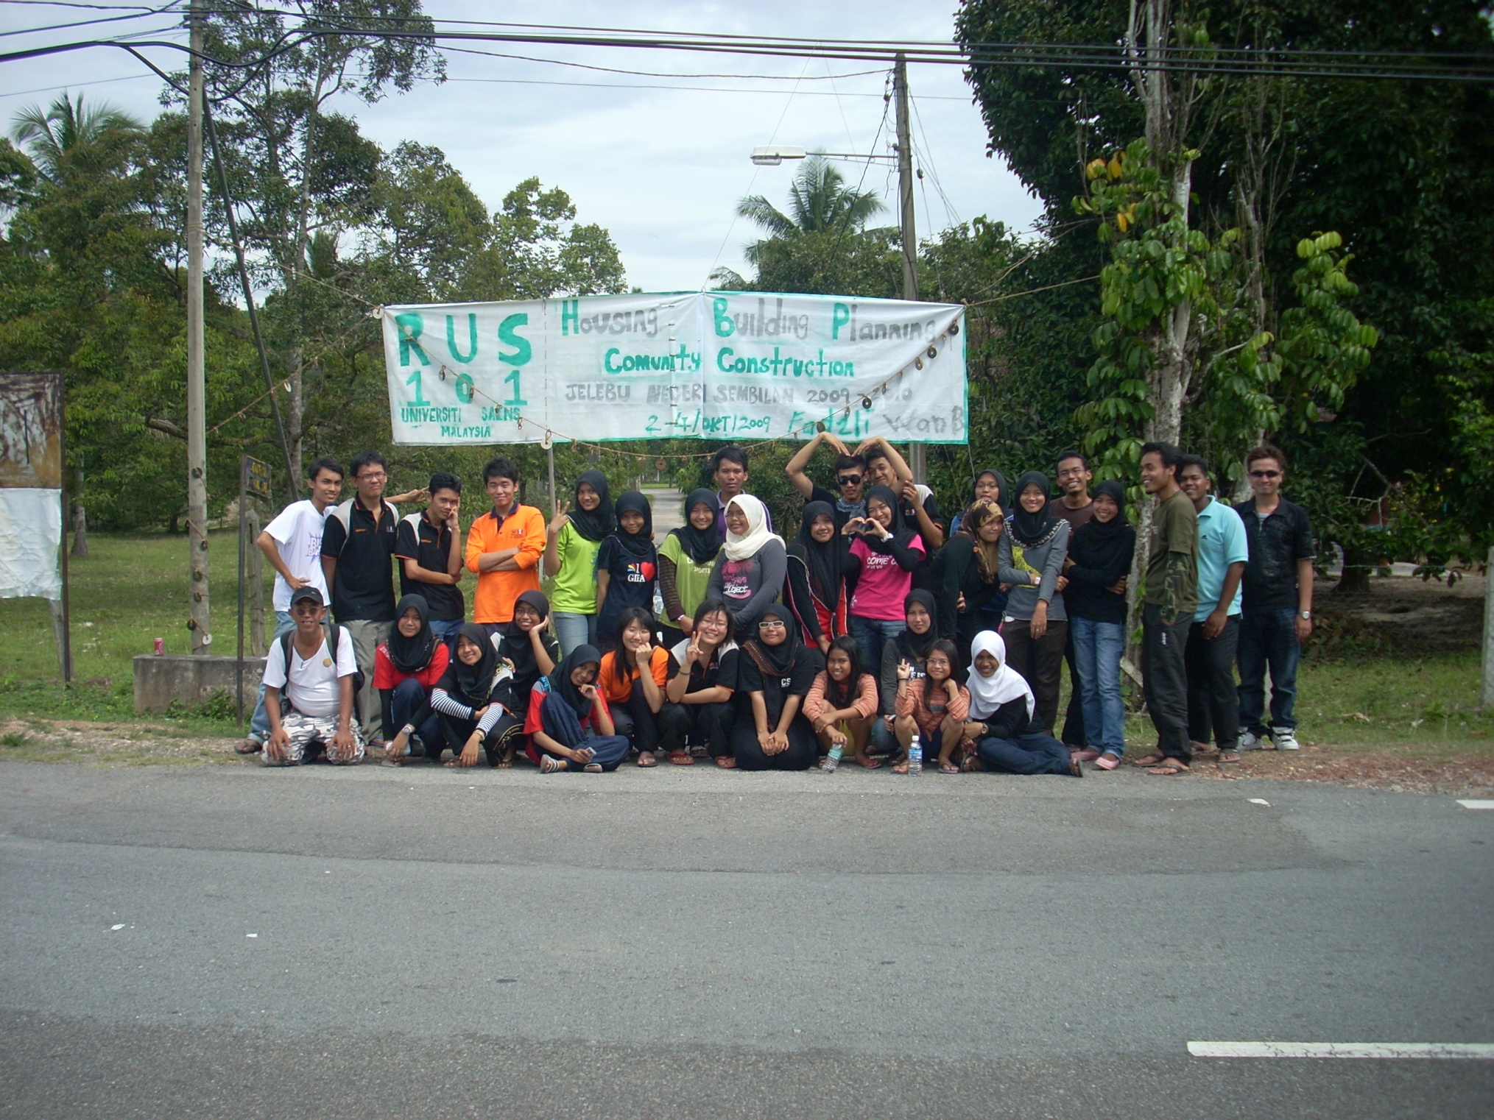
THE END
THANK YOU
KHOR SHUIN CHENG (103680)
QUANTITY SURVEYING

Slide 10
KHOR SHUIN CHENG (103680)
QUANTITY SURVEYING

